Slide 1

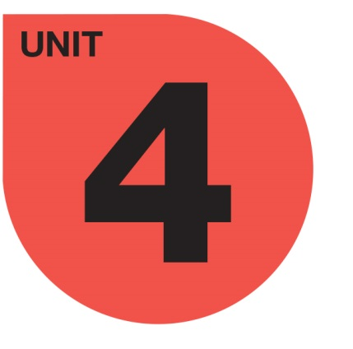
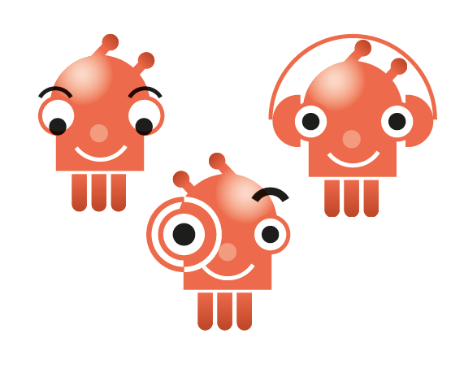

social
sciences 5

Slide 2



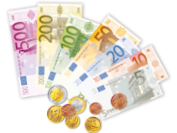
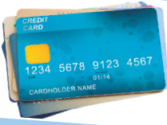
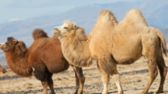
What’s money used for?
Money is any object of value that can be exchanged for a product or service. Nowadays we use coins and paper notes, but in the past, many things have been used as money, such as animals, sacks of grain, shells or beads.
Most people now keep their money in a bank account. We can use debit cards and credit cards to pay for things.

Slide 3
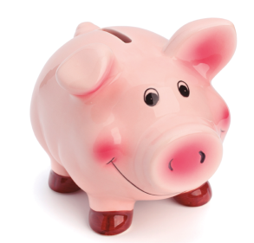
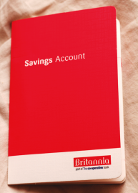
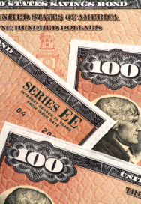
How can we save money?
Money box: a money box is a box or container where people save money. You can put money into a money box whenever you want.
Savings account: many people use a savings account to save money. They put money into the account, and the bank pays interest on it.
Investing money: when you invest, you buy something with the objective of selling it later for more money. People often invest in shares or bonds.

Slide 4
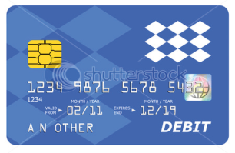
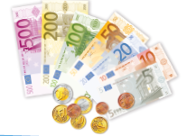
How can we spend money?
We can use cash, and we can also use debit cards and credit cards.

Slide 5
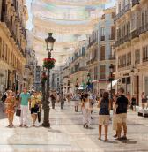
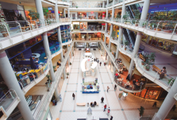
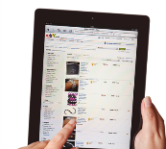
How do we spend our money? Where do we spend money?
We spend money on high order products like cars and houses. We spend money on low order products such as food, drinks and medicines. We buy these every week.
We spend money in town centres, shopping centres and on the Internet.

Slide 6
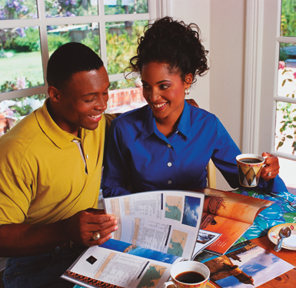

What’s a budget? What types of budgets are there?
A budget is the amount of money that we have to spend. Budgets help us control how much we spend.
Household budgets: many people use budgets for their shopping.
Business budgets: many businesses use budgets to plan how much they will spend on raw materials and products.

Slide 7
What have we learnt?
We can save money by…
using money boxes
using savings accounts
investing money

Slide 8
What have we learnt?
We can spend money in…
town centres
shopping centres
the Internet

Slide 9
What have we learnt?
We can spend money on…
higher order goods
lower order goods

