Slide 1




social
sciences 5

Slide 2


What’s the tertiary sector?
The tertiary sector consists of activities that provide a service, such as selling consumer products. We use many services such as transport, communications, health care and education. We consume products such as food, clothes and toys. Everyone who uses a service or buys consumer products is a consumer.

Slide 3



How’s the tertiary sector divided?
Doctors, nurses and dentists all work in the health sector. Teachers work in the education sector.
There are people who work in public safety, such as police officers.
Some people work in skilled jobs, such as mechanics and electricians.

Slide 4
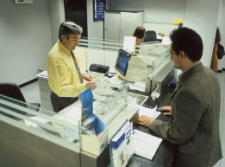


How’s the tertiary sector divided?
Some people do administrative work, such as secretaries, bank clerks and civil servants.
Some people work in cultural professions, such as writers, musicians, actors, painters and sculptors
There are people who work in the judicial system, such as lawyers, prosecutors and judges

Slide 5
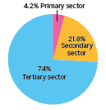
Which sector is the most important in Spain?
In Spain, more people work in the tertiary sector than in the primary and secondary sectors combined.

Slide 6


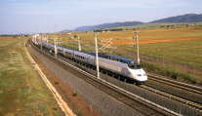

What types of transport are there?
Water transport: cruise ships carry thousands of passengers on holiday tours. Cargo ships transport heavy products over long distances.
Road transport: land vehicles, such as cars, buses and lorries, travel on roads.
Rail transport: passengers and products can be transported by rail.
Air transport: planes are used to transport passengers and products over long distances.

Slide 7
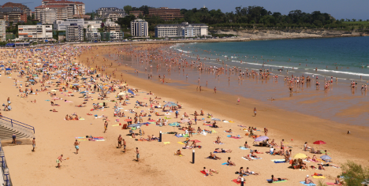
What’s the tourism industry like?
There are many different types of tourism, such as beach tourism, cultural tourism, rural tourism and adventure tourism. Spain is one of the most popular tourist destinations in the world.

Slide 8

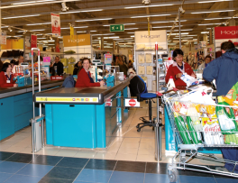

What’s retail?
Retail is the selling of products to consumers.
Very large supermarkets are called hypermarkets. Hypermarkets sell food and many other products, such as clothes, furniture and electronics.
Supermarkets and department stores are large businesses that sell a variety of diff rent products.
Speciality shops are smaller businesses that offer only one type of product or service, for example, camera shops and opticians.

Slide 9
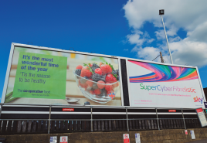
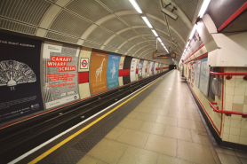
How are products advertised?
There are many ways to advertise products and services. The most common ones are on television, on the Internet and in newspapers and magazines.

Slide 10
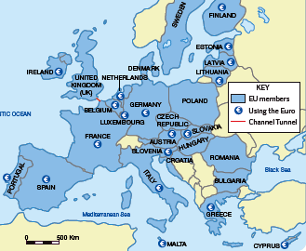
Why’s the tertiary sector important in the EU?
EU member countries have many economic links that make it easier for countries to trade with other member countries. In recent years, transport links have improved in the EU. It’s easy for EU companies to do business with each other because their offices are open at the same or similar times.

Slide 11
What have we learnt?
The tertiary sector is divided into different areas…
education sector
administration
judicial system
health sector
public safety
cultural professions
skilled jobs

Slide 12
What have we learnt?
There are several types of transport…
water transport
rail transport
road transport
air transport

Slide 13
What have we learnt?
There are several types of retail businesses…
hypermarkets
supermarkets and department stores
speciality shops

