Slide 1




social
sciences 5

Slide 2
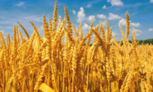


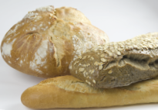
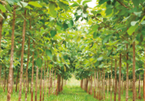
What’s the economy?
The economy is a system. It involves transforming products from nature into manufactured products, and buying and selling products or services. Products that we get from nature are called raw materials.

Slide 3
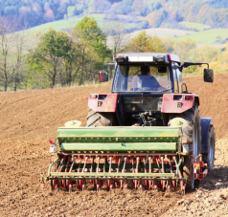
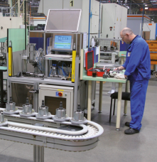

What are the three sectors of the economy?
The primary sector: raw materials are extracted from nature. Agriculture, forestry, mining and fishing are primary sector activities.
The secondary sector: raw materials are processed or used to manufacture new products. These products are manufactured in factories and workshops.
The tertiary sector: activities that provide a service make up the tertiary sector.

Slide 4
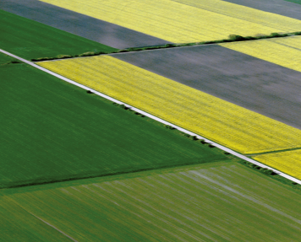
What’s agriculture?
Agriculture is the cultivation of crops and the raising of livestock. Crops and livestock both come from nature, so agriculture belongs to the primary sector.

Slide 5
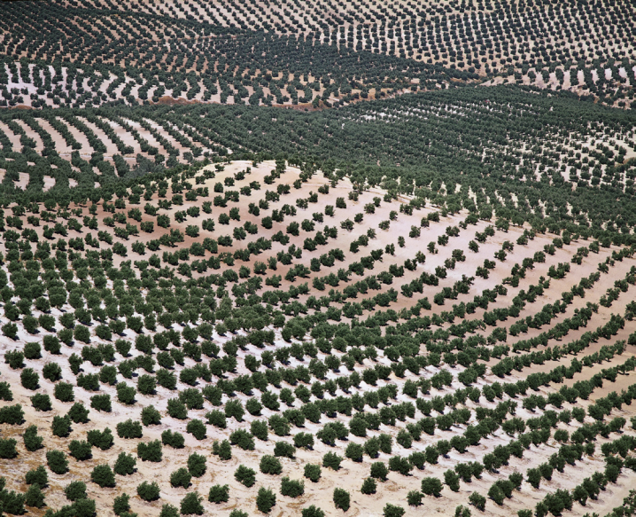
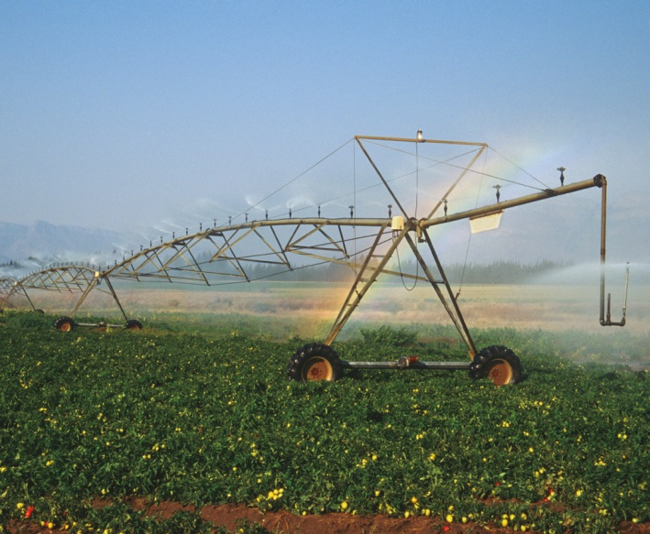
What’s arable farming?
Arable farming produces crops for food and other products. There are two types of arable farming: dry farming and irrigated farming.

Slide 6
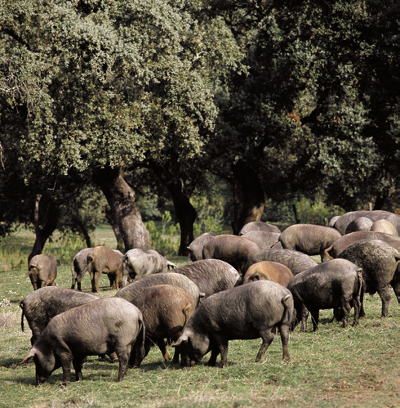
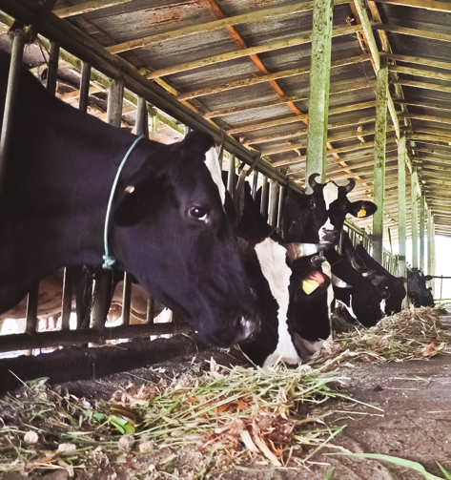
What’s livestock farming?
Livestock farming is the raising of animals for food and non-food products.
There are two types of livestock farming: extensive and intensive.

Slide 7
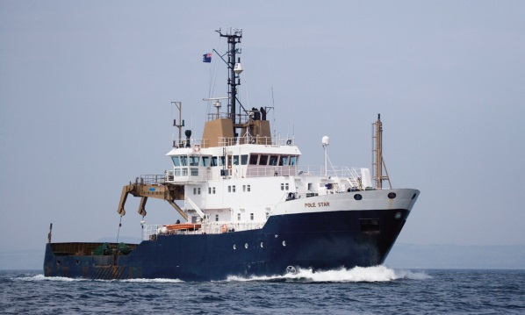
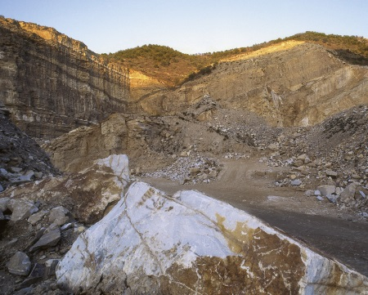
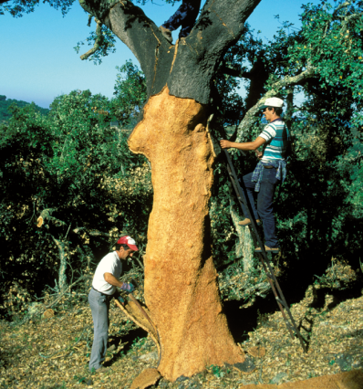
What other primary sector activities are there?
Fishing: there are two main types of fishing: coastal and deep-sea.
Mining: mining is the extraction of rocks and minerals from the ground.
Forestry: forestry is the use of forests to obtain plant products, such as wood, cork, cellulose and resin.

Slide 8
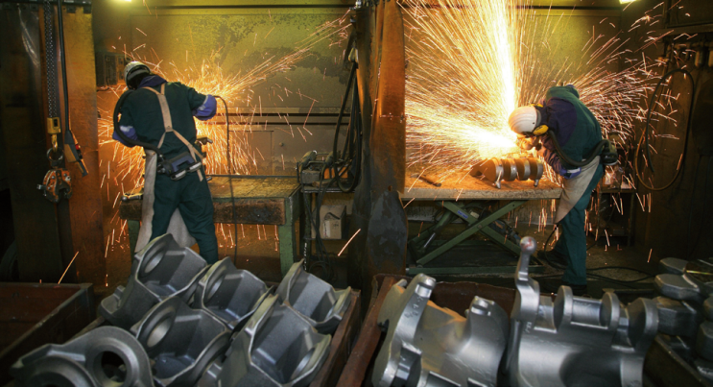
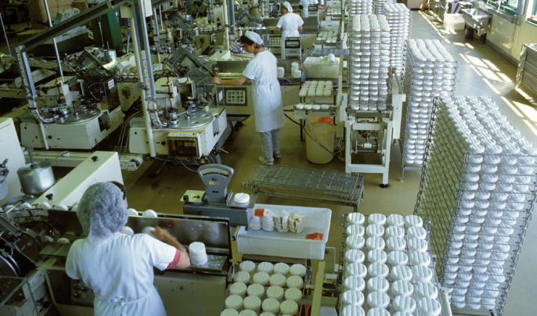
What does the secondary sector produce?
Intermediate products: some industries produce intermediate products. These are products that are used by other industries. Steel is an intermediate product.
Consumer products: some industries make products that are sold directly to consumers.

Slide 9
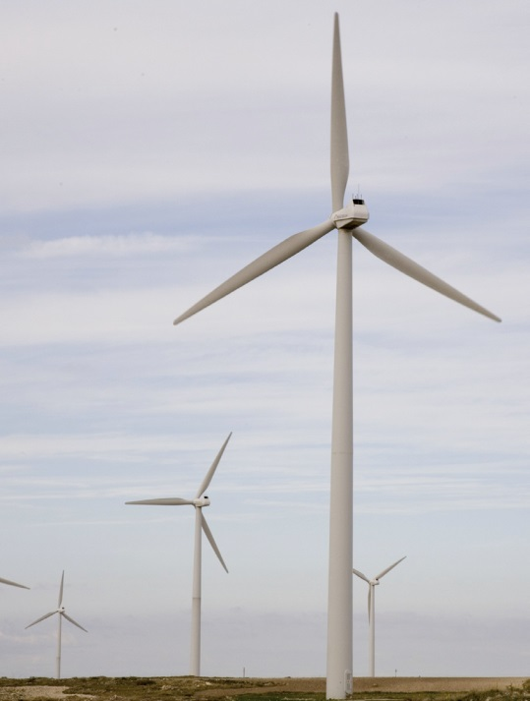
How are factories powered?
Factories need energy to transform raw materials into products. Some energy comes from renewable sources, such as sunlight, water or wind. Some energy comes from non-renewable sources, such as coal, oil, natural gas and nuclear energy.

Slide 10
What have we learnt?
The three sectors of the economy are …
the primary sector
the secondary sector
the tertiary sector

Slide 11
What have we learnt?
The two types of arable farming are…
dry farming
irrigated farming

Slide 12
What have we learnt?
The two types of livestock farming are…
extensive farming
intensive farming

Slide 13
What have we learnt?
Primary sector activities include…
agriculture
fishing
mining
forestry

Slide 14
What have we learnt?
Secondary sector industries produce …
intermediate products
consumer products

